Slide 1
Waterboxx Components
Evaporation Cover
Waterboxx
Tan
Waterboxx Cover
Wick
Two blue siphons
Evaporation Cover Black
Round blue cap

Slide 2
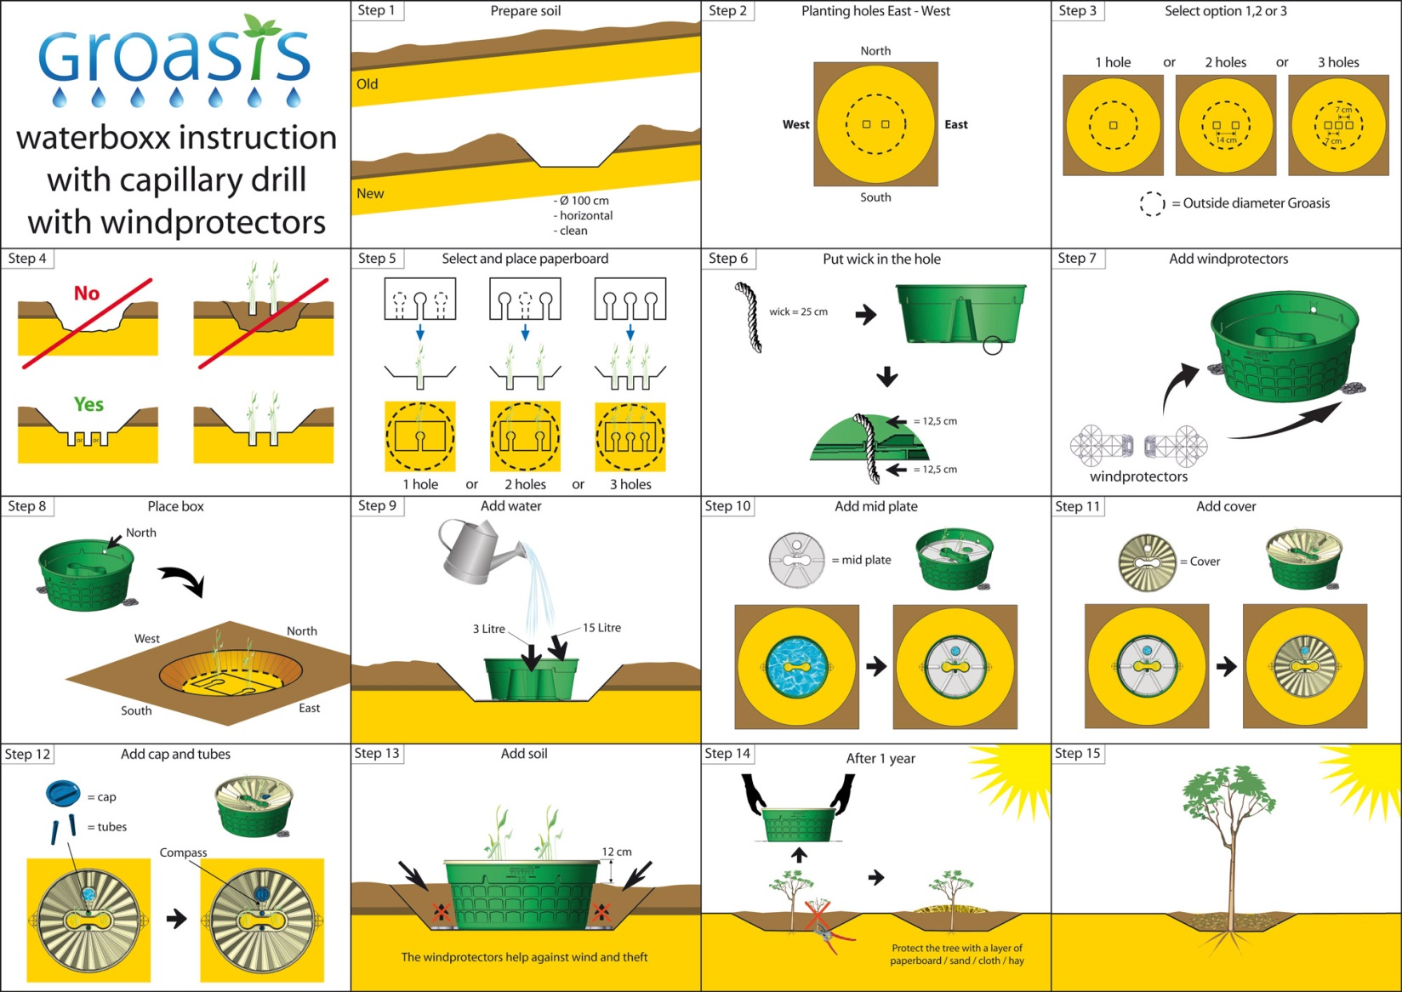
Installation

Slide 3
Waterboxx Ground Preparation
Once you select you planting location, orient yourself to the North. Dig a hole approximately 8 inches deep and 22 inches wide. Fill with 10 gallons of water and let set overnight.
If your plant is in a plastic 4 inch pot, remove from the pot and cut 1 inch oﬀ of the root base.
Locate your white anti evaporation cover and orient it to the North. If you are planting only one plant, remove the center punch-­‐out. If you are planting two, then remove the outer punch-­‐outs, and for three plants, remove all punch-­‐outs.
Dig a 3 inch whole in the ground for each plant remembering the North orientation and place the plant(s) into the hole(s). Cover the plant up to the base with soil.
Slip the white evaporation cover along the ground centering each plant within the punch outs remembering to North orient the anti evaporation cover and the plants.
Assembly of the Waterboxx
Lets start with the Waterboxx base.
Locate your wick, and from the bottom of the Waterboxx locate a ¼ inch hole. Using a screwdriver push the wick through the base allowing a minimum of 4 inches to extend out of the bottom.
Locate the black evaporation cover and set inside the Waterboxx. The round hole should be placed near the 1 inch hole on the side of the Waterboxx. Note: The evaporation cover (black) is place so the recessed side is down along the edge and the two small 1 inch holes drain down into the Waterboxx.
Place the tan cover on the Waterboxx matching the two holes – one to the evaporation lid and
other to the 1 inch hole on the side of the Waterboxx. This hole allows for excess water to drain out of the Waterboxx.
Snap the two inside clips to the inside of the Waterboxx cover and press ﬁrmly down around the Waterboxx. You will hear it lock into place.
Insert the two blue siphons and push down until they click into place. Your Waterboxx is now
Ready for installation.
Installation of the Waterboxx
Place the Waterboxx over your plant(s) insuring the 1 inch hole located on the Waterboxx side is pointing North.
Add slowly 1 gallon of water into the center where the plants are located in such a way that you
do not wash out the roots.
Add 4 gallons of water into the round hole in the Waterboxx cover, ﬁlling the Waterboxx.
Secure the blue cap in the round hole and turn until it snaps.
For more information about this product Please visit us at www.AgrotreeSolution.com

